Slide 1
Manifest Documentation 1: JSON
Documenting JSON
How Manifest.json can be described
Notes:
<number>

Slide 2

JSON: Describing a manifest file
{
"manifest_version" : 2,
"name":"Budget Manager",
"version": "1.1",
"description": "This extention use for tracking oerall expenses",
"browser_action":{
"default_popup": "popup.html",
"default_icon": "./Logo.png"
},
"icons":{"128": "Logo_128.png"},
"options_page": "option.html",
"background":{
"scripts": ["./eventpage.js"],
"persistent": false
},
"permissions": [
"storage",
"notifications",
"contextMenus",
"tabs",
"tts"
],
"commands": {
"_execute_browser_action": {
"suggested_key": {
"default": "Ctrl+Shift+F",
"mac": "MacCtrl+Shift+F"
},
"description": "Opens popup.html"
}
}
}
Notes:
<number>

Slide 3
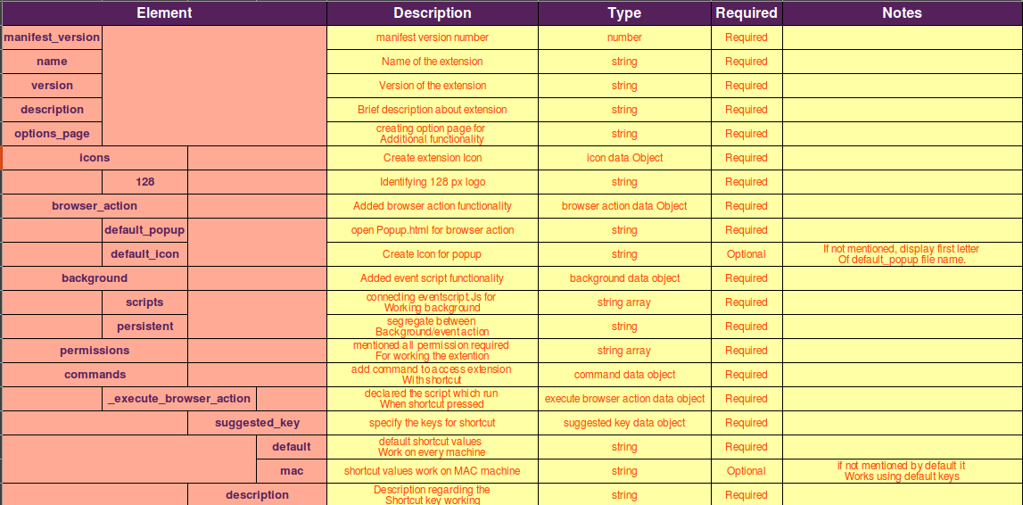
Manifest Documentation
Notes:
<number>

Slide 4
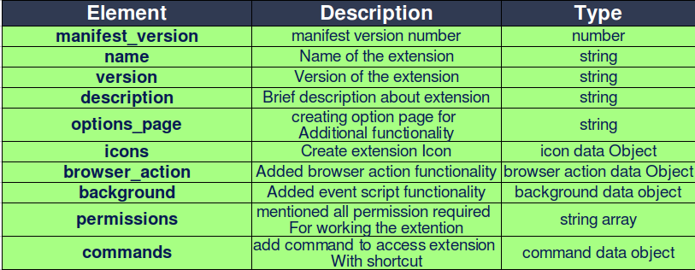
Manifest JSON Documentation (tables)
Manifest object: Represents a extension.
Notes:
<number>

Slide 5


Manifest JSON Documentation (tables)
Icons object: Represents a Icon Logo.
Browser Action object: maintain data for connecting Popup.html.
Background object: Represents data for event action.
Notes:
<number>

